Slide 1
Transforming care for Children and Young People in London
Eugenia Lee GP Lead, Children and Young People’s team HLP
PICH
February 7th 2018

Slide 2
Summary of session
Population health perspective of health needs of CYP in London.
Consider what are the possibilities and how the health needs can be met?
- Understanding the role of HLP
- An overview of Programme activity, including:
Asthma uptake
Primary Care,
Mental Health
Child Sexual Assault programme
CDOP
Digital work: Health Passport and NHSGo

Slide 3
Introduction
Me- GP trainer, Programme Director, Appraiser, CEPN lead, Out of hours, HLP GP lead.
Who you are?
What do you think health needs of CYP in London is?
What can you (and your part of the system) do to help?

Slide 4




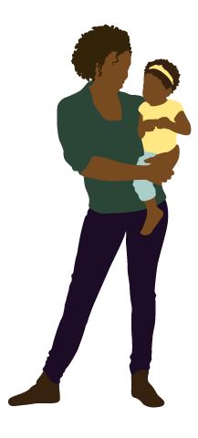



Whole System Approach to Transformation for Children and Young People’s Health
System Leadership (CYP Board and clinical leadership group)
Long Term Conditions
Asthma standards
Asthma toolkit
Asthma baseline audit
Epilepsy standards
Primary Care
GP federation pilot model care CYP
Population based data
Toolkit for GP federations
Prevention and self care
NHSGo
Marketing campaign
Community Pharmacies
Audit of CYP with asthma
Online learning hub for MURs
Audit CYP with dental pain
Role of pharmacists CYP health
Mental health
LTP refresh support
Guidance for mental health crisis
Models of liaison psychiatry
Benchmarking/KPIs
Eating disorders CoP
Thrive (Mayor)
Learning disability (theatres)
Out of Hospital care
Compendium models of care
Standards for OOH care
Modelling impact different models
Urgent and Emergency Care
Acute care standards
Peer review
PAU standards
L1 and 2 PCC standards and education
CDOP
Baseline audit
Suicide prevention
Bereavement
Sharing data and learning
Cluster level working
Schools
Models of school nursing
Guidance for management CYP asthma, epilepsy and diabetes
Improved integration of care across the system for CYP
System wide enablers
Place based care and planning (data packs, support for networks)
Workforce
Commissioning development programme

Slide 5
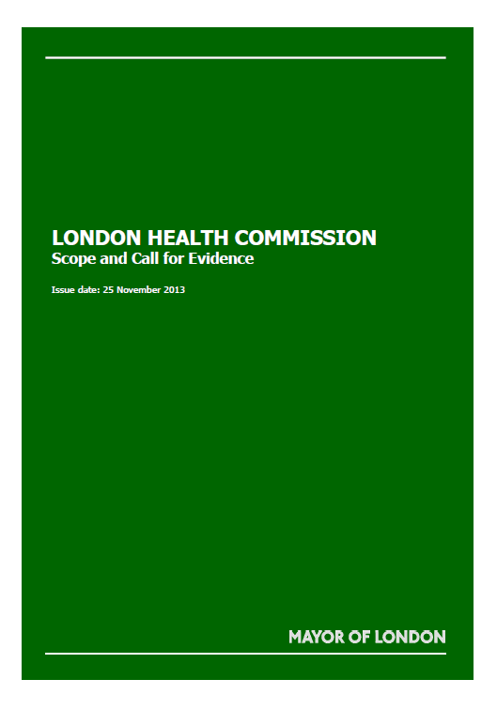



London Health Commission
Healthy London Partnership –
The delivery arm of the London Health Commission

Slide 6
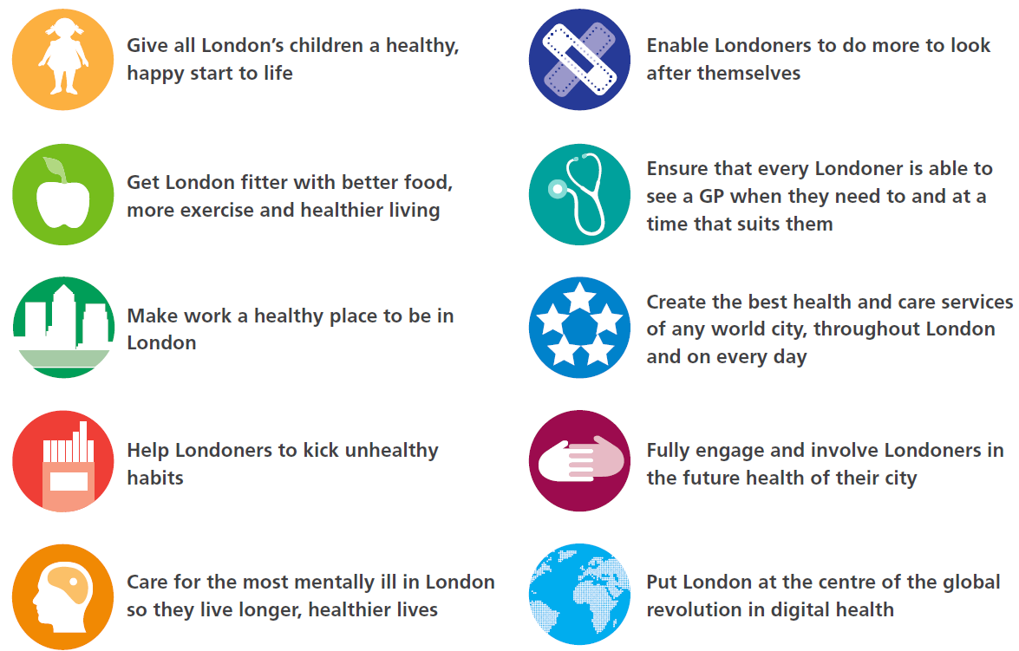
Goal – London to be world’s healthiest global city
10 programme aims from London Health Commission

Slide 7
  Healthy London Partnership Children and Young People Programme Governance
CCG SRO & SEL SPG (Martin Wilkinson)
NHSE SRO (Will Huxter)
CYP Clinical Director (Russell Viner)
CCG Clinical Lead (Nicola Burbidge)
SPG rep SWL (Adam Doyle)
SPG rep BHR (Louise Mitchell)
SPG rep WELC (Satbinder Sanghera)
SPG rep NCL (Sarah Price)
SPG rep NWL (Matthew Hannant)
DPH (Dagmar Zeuner)
PHE (Marilena Korkodolis)
DCSS (Linzi Roberts-Egan)
CYP/family rep (Emma Rigby)
Programme Manager (Tracy Parr)
GP lead (Eugenia Lee)
Strategic Lead CAMHS (Steve Ryan)
NHSE asthma lead (Dave Finch)
London Health Board
London Transformation Group
(London’s CCGs and NHS England)
Prevention Board
HLP C&YP Transformation Board
Primary Care Board
U and EC Board
Mental Health Board
Specialised Services Board
CYP Clinical Leadership Group
CYP Commissioning Advisory Group
Young People’s Steering Group
Accountable
Information sharing/ endorsement
Programme alignment
Critical Care Clinical Leadership Group
Primary Care Clinical Leadership Group
Surgery Clinical Leadership Group
Asthma Clinical Leadership Group
Out of Hospital Care Clinical Leadership Group
CAMHS Clinical Leadership Group
CYP & Families Engagement throughout
V0.9 Jan 2016

Slide 8
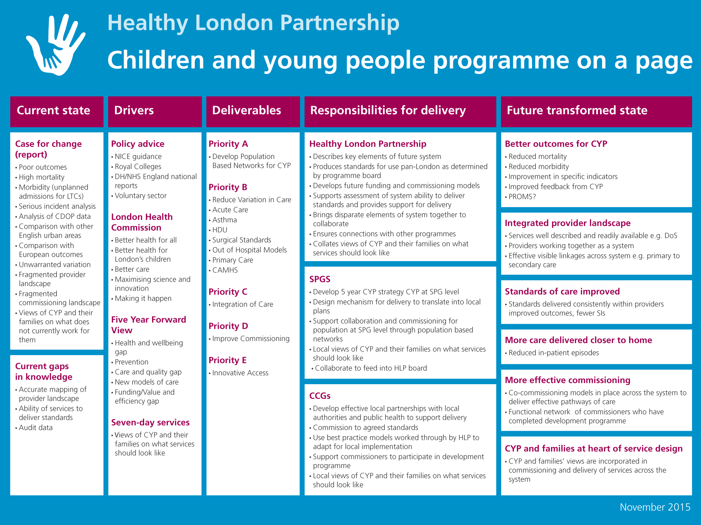

Slide 9
Some data

Slide 10


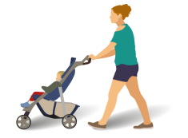


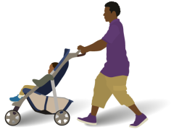


Healthy London Partnership –
Children and Young People’s programme
Children’s services in London: Key facts
8.2 million
people live in London
of which
20% of 4-year-olds are overweight or obese
2,049,576
are children aged 0-19
Mental Health conditions affect
1 in 8
Children
Emotional and
behavioural
problems affect
1 in 5
Children
600,000
of London’s children
live in poverty
25% of 15-year-olds
LESS THAN HALF
of 11-15
year olds do
an hour of
exercise each
day
134,186
live births in
London in 2012
First smoked
AGED 13 or younger
40%
of 15-year-olds
drink alcohol
once a week
20%
of 13-year-olds
drink alcohol
once a week

Slide 11


Healthy London Partnership –
Children and Young People’s programme
1 in 10
of babies born in London
are admitted to
neonatal units — 13,596
each year
282
of those
babies do
not survive
(2.1% of
admissions)
5,570
of babies born in London admitted to neonatal units were born at 37-40 weeks (gestational age)
Brain tumours
account for
25%
of all childhood
cancers
22%
of the babies
who died
were born at
37-40 weeks
gestation
The most common
malignancy is childhood LEUKAEMIA
at 41%,
including
lymphomas
Congenital heart disease (CHD) is the most common congenital abnormality
8 in 1,000
babies born in England will
have some form of CHD
Incidence of Type 1
diabetes is increasing
by about
South Asian and African
Caribbean people
Are 3-5 times more likely to suffer kidney failure requiring dialysis than white Caucasians
4%
each year
- even more
quickly in children
under five.
A recent survey
of DGH service
provision shows
that nearly half of
hospitals operate
on less than 51
elective paediatric
surgical cases per
year
3,600
paediatric surgical
procedures are
performed each year
More than 29,000 children in the UK have Type I diabetes.
You would need
70
jumbo jets to
take them all on
holiday
In London, there
are more than
3000
with Type 1 diabetes
3%
of children
have written
asthma plans to prevent and
manage
exacerbations
679
children are on renal replacement therapy in the UK
212 of these are treated in London
>50%
of London hospitals
report that they do
not always have an
anaesthetist with paediatric
Training on call for paediatric emergency cases.
1/3
of children’s
admissions for asthma
could have been
prevented with optimal
primary care
There are
130
renal transplants undertaken on children in the UK each year
25% of UK transplants for children are done at GOSH
Whilst there are 13
tertiary centres across the UK, just
10 of those 13 provide renal transplantation
11% are done at Evelina
1/2
of all NHS expenditure on patients with IBD is for inpatient management (approximately)

Slide 12
What do children, young people and families think?
I want to know that my GP is experienced in caring for children
We need easier access to healthcare
Make sure the school can look after my son when he has an asthma attack
Services are not joined up
I am worried about what will happen next year when I am too old for the children’s clinic
I need rapid access to someone I can talk to when I feel depressed

Slide 13
Fragmented CYP Commissioning Responsibilities
CCGs
NHSE Spec Com
NHSE Primary care
Routine newborn services
Secondary care
Community services
CAMHS
Urgent and emergency care
Out of hours primary care
Specialised services
CYP retrieval services
Primary medical services
Pharmaceutical services
Dental services
Optical services
Health in the justice system
PHE
LA – public health
Healthy child programme
School nursing
Health visiting (2015)
Measures to address obesity
Sexual health services
Mental health promotion
Oral health promotion
Drug, alcohol and smoking cessation services
Public health services 0 - 5yrs
Child health information system
Immunisations
Screening (ante and post natal)
Sexual assault referral centres

Slide 14
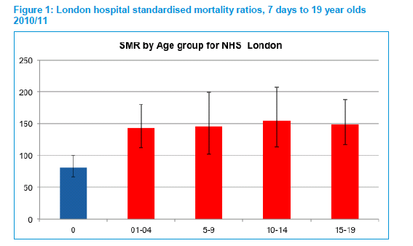
London has higher than expected mortality for 1 – 19 year olds
Data courtesy of London Health Programmes

Slide 15
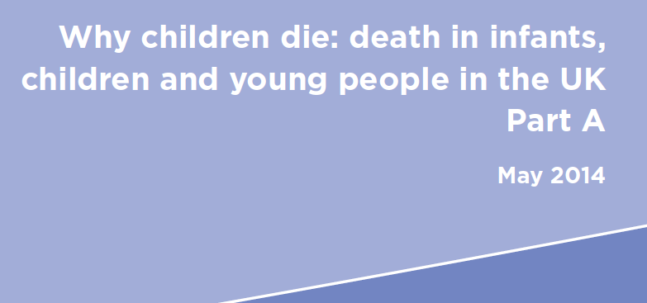

Causes of high CYP mortality
Higher overall mortality in UK
Higher infant mortality and in CYP with long term conditions
Injury including intentional injury deaths
Many preventable deaths
Marked social inequalities

Slide 16
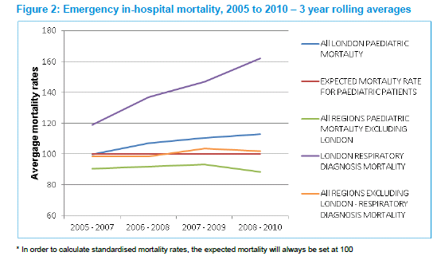
Hospital mortality for children in London is rising compared to other areas of UK

Slide 17
MORTALITY DATA
675 children and young people (CYP) aged 0-19 years died in London in 2014
Although there have been significant reductions in child deaths in the past three decades in England, too many children are still dying unnecessarily
• If the UK had the same childhood mortality for children aged 0-14 years as Sweden there would be five fewer child deaths every day and about 1,951 fewer child deaths every year
• In 2014, almost one in three child deaths in England and Wales was avoidable
• In 2015, about one in four child death reviews in England was identified by CDOPs as having a modifiable risk factor

Slide 18
Attendance at A & E by children is very high in London
26 London boroughs have A and E attendance higher than the national average for children
Data courtesy of ChiMat

Slide 19
Some boroughs have high rates of admission to hospital for asthma

Slide 20
Your turn
Groups of Four
Pick a health outcome
What would you do?
How?
What would make it work? Consider: workforce, infrastructure, estates, finance, governance, contracts level.
Pitch to the rest of the group.

Slide 21
Pitching

Slide 22
What is HLP doing?

Slide 23
Asthma audit highlights
Interim results
1,858 Community pharmacies across the whole of London were invited to a take part
1,101
Pharmacies
responded
60%
of the total number of pharmacies
32
boroughs (all) took part
Participation per borough
9,462
responses
9.4
Average age of participant
Campaign
extended to 10 weeks
till 2 October
9
Average entry per pharmacy
1 in 4
Entries were using a smart device
Results
64%
Did not have a flu jab last year
25%
Had to make an emergency request for an inhaler in the last 12 months
48%
Do have an asthma action plan or wheeze plan
70%
Had a inhaler technique assessment in the last 12 months
64%
Have a spacer device
23%
Live with someone who smokes
96%
Do not smoke

Slide 24
Future model of care for children and young people
Population approach
Promotion of a healthy city is a city that looks after its children and young people
Ensures children and young people are seen as an integrated service with no gaps, which is provided close to where the users are living or learning and has streamlined access
Ensures that service provision is consistent and accessible across STP/ CCG / local authority area, while still allowing flexibility to meet need at community neighbourhood area and primary care cluster/network/federation level
Ensures children and young people are safeguarded, including early identification and co-ordinated support of emerging need
Emphasises early help to reduce the need for children and young people to access intensive or statutory services
Develops close working relationships and integration with social care, education and other health partners as paramount to creating a seamless service
Supports children and young people to be able to self-care where possible and appropriate
Develops a fully integrated information technology system that allows the seamless transfer of/access to appropriate clinical and non-clinical information across all services
Is able to deliver efficiencies with no compromise in service quality

Slide 25
Asthma Update
Asthma Programme: An exemplar for CYP integrated care
Severe asthma CQUIN work in progress through NHSE Spec com to develop asthma networks
Implementation meeting 28th Feb To discuss NICE guidance (spirometry and FeNO in CYP implementation and any need for changes in standards. Asthma CDOP checklists near completion
Health Passport:, PRSB work in progress, national linkages and working with CHIS in SWL. Initial engagement work with diabetes teams commenced
NEL
NCL
NWL
SWL
SEL
NEL STP asthma pathway group- agreement from Linda Hassell to chair
Working with LAS and schools re handovers. School generic contacts shared for NEL
Agreed use of single asthma action plan across STP (Asthma UK) implementation in progress
2 recent deaths in BHR
Agreement to pilot health passport at BLT
NCL asthma peer review of acute services completed – reports being drafted (schools, primary care and pharmacy in progress)
Board proposed an STP asthma network which will be discussed at meeting 31st Jan
GOSH has set up severe asthma network 2nd meeting 31st Jan
CQUIN work with SGH resulted in additional staff
Asthma training to 250 staff in Croydon Inset day 3rd Jan
Engagement with SGH re health passport pilot
Bexley group consultation training Vision asthma template and prevalence finder in testing phase
Bromley CCG established an asthma group
STP in discussions around priorities
Bromley Asthma group
NWL asthma dashboard
Hammersmith & Fulham testing prevalence finder
Working with NWL re health passport
Engagement in Big Asthma Room at Imperial

Slide 26
Local activity in London to date
Harrow 18% reduction in admissions through HLP audit
Barnet 9 teaching sessions for HCP
NCL STP CYP network set up asthma is a priority. Whole system Peer review- nurses on panel
Islington Asthma Friendly Schools project. Child Integrated Network looking at asthma (CHINs)
20
Hillingdon
New integrated team, trained 70 school staff
Barnet
Enfield
21
Harrow
Barnet
North
Middlesex
2
Northwick Park
Haringey
Waltham Forest
NEL MDT Paediatric Asthma working group
Hillingdon
Royal
Free
Whipps Cross
King George
Brent
Whittington
34
Redbridge
33
NWL MDT Asthma Network
19
22
31
Queen’s
Camden
Islington
Homerton
29
4
Ealing
Hackney
Hillingdon
Westminster
UCLH
Royal
London
Havering
Ealing
St Mary’s
18
28
Tower Hamlets
Newham
Barking and Dagenham
Imperial
GP training session for NWL 100+
H&F
1
City
Newham
Charing
Cross
West Middlesex
K&C
48
32
Work with AUKUR on health passport
Hounslow
5
6
Southwark
C&W
St Thomas’
46
49
H & F Event for parents carers & clinicians
Richmond
Wandsworth
Lambeth
King’s
Queen Elizabeth
Greenwich Right care project
50
Greenwich
62
60
Lewisham
Bexley
Video on GP practice screens in NWL
Kingston
St George’s
Lewisham
Kingston
Merton
Bexley Pharmacy project with 3 GP practices and 9 pharmacies. Group consultations
61
Testing Asthma dashboard and templates
63
Croydon
SWL CQUIN resulted in 4 new CNS, additional Dr, physio across SWL
St Helier
Bromley
Epsom
Sutton
Croydon
Princess Royal
CHYP programme
47
GP pilots
Hammersmith & Fulham CCG
Bexley CCG
Islington CCG
CQUIN, GP training, CNS
CHAH- Croydon community hospital at home team
Interest from Boxing England, 2 football clubs and after schools clubs in SEL to train up their coaches

Slide 27
Primary Care
Mapping what a primary care hub service for CYP would look like – workshop February
Bexley pharmacy pilot – inhaler technique reviews Interest in rolling out in Greenwich and Islington Filmed asthma review In pharmacy use on website
Bexley practice testing use of Vision template for asthma prevalence and reviews
Group consultations for CYP with asthma and cystic fibrosis being piloted. Interest in implementing in Lewisham and Croydon
Hammersmith and Fulham – training event for 100 GPs and primary care professionals on asthma in CYP. Followed this with a fun family event for patients and families with asthma
Asthma radar (Dashboard) developed and in pilot phase. Opportunity to expand to wider NWL CYP dashboard
Piloting SystmOne asthma templates and prevalence finder

Slide 28

UEC, OOH and acute care
Alignment with Urgent and Emergency Care (UEC) work
Level 1 and 2 paediatric critical standards
On line learning
Peer reviews in a number of areas
Surgery networks (NCL)
Implementation of Out of Hospital (OOH) standards
Compendium: New Models

Slide 29
Percentage of Children who can be managed in alternative models instead of ED
Nurse led acute illness team (Primary care)
14.1%
Community walk in centre for illness
28.4%
MCP for CYP
25.7%
Enhanced GP practice
28.4%
GP confederation with enhanced paediatric skills
44.6%
Community walk in centre for illness and injury
64.3%
PACs system for CYP
75.5%
Community pharmacy
9.5%
Current GP practice
21.1%

Slide 30
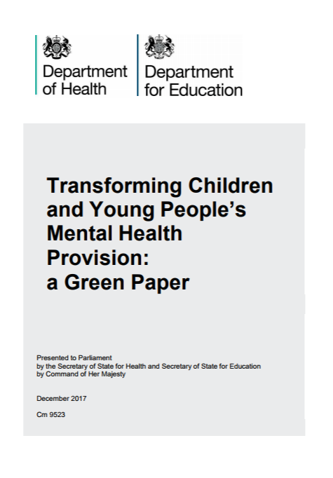
CAMHS
Green Paper published Dec 2017
Incentivising every school and college to identify and train a Designated Senior Lead for Mental Health to oversee the approach to mental health and wellbeing
Funding (?how) new Mental Health Support Teams, supervised by NHS children and young people’s mental health staff, to provide specific extra capacity for early intervention and ongoing help. Their work will be managed jointly by schools, colleges and the NHS. (there will be a call for Trailblazer sites)
Trialling a four week waiting time for access to specialist NHS children and young people’s mental health services
Consultation ends March 2nd – HLP to formulate response

Slide 31
CAMHS
CAMHS and MH and WB in Schools
Meeting with Mayor to discuss approaches to support mental health in schools
Very supportive and will work collaboratively with HLP and schools
Additional funding obtained for project manager to lead this work
Peer review of mental health crisis services for CYP
Site visits completed in two areas – nine in total to be undertaken
Whole system approach taken to peer reviews
Other
Data survey completed by CCGs and results analysed and reported. Findings include that 85% of non-NHS providers in London flow CYP MH data to CCGs but 83% do not flow data to the NHS Digital Mental Health Services Dataset.
Circulated draft Primary Care Professional Eating Disorders summary guidance for engagement with GP CLG, MH providers
Circulated revised CYP MH training resource compendium for final engagement with mental health trusts before design/format final version agreed for publication
Started profiling CAMHS services in MiDoS
Undertaking review of evidence and frequency of Out of Area placements

Slide 32
CDOP
Submitted response to “Working together to safeguard children” consultation (moving CDOP responsibility to joint CCG/LA and working at larger scale)
CDOP workshops scheduled for 2018
Understanding Youth Violence
Transformation Support Event
Mass Mortality/Major Incidents Transformation Support Event
Programme Close
CYP Bereavement Experience Measure (BEM) drafted to augment existing Maternity BEM working with national team and SANDS
HLP CDOP Asthma and Allergy Deaths checklist in final draft
Suicide prevention resource in final draft

Slide 33
Linkages – Child Sexual Assault transformation
“CSA Transformation programme – a 12 month programme to enable the delivery of Child Sexual Abuse (CSA) hubs in five STP areas of London”
London CSA review findings (2015) – Low levels of CYP identified/supported, lack of long term support and CYP/families, no clear pathway, only 25% CYP offered medical support and high thresholds and long waits for therapy from CAMHS.
CSA Transformation Programme (2015-17) – 2 CSA hubs created in London in NCL and SWL. Business case development for 3 further CSA hubs in each STP.
NCL CSA hub evaluation – 144 CYP supported with families in first 6 months, four fold increase in referrals, enabled professional development, removal of barriers to accessing advocacy and CAMHS support, improved communication with children’s services and PROMs developed/piloted.
CSA Transformation programme (2017/18) – roll out CSA in each STP.
Links to Child House Programme – NCL/SWL CSA will develop into
Child House funded by Home Office. Seek funding for other Child Houses
CSA Toolkit developed.

Slide 34
Digital Health Passport
Policy
Five Year Forward View
Personalised Health and Care 2020
Local Digital Roadmaps Sept 15
Local Digital Roadmap Guidance April 16
Local health and care systems to produce Roadmaps, setting out how they will achieve these commitments.
London Digital Plans
Notes:
Visually pleasing, able to host multiple care plans, able to record patient symptoms, days off school, medication use and more, easy access to emergency plan, links to educational resources.

Slide 35
NHSGo
NHSGo designed for young people by young people
Key Statistics
Launched July 2016
53,000 downloads
500,000 screen views
Most popular sections mental health (depression/anxiety) and sexual health
16,000 likes on the NHSGo Facebook page
Winner ‘Championing the Public’ category at PEN National Awards 2016
Nominated in Nursing Times Awards and Positive Practice in Mental Health Awards 2017
3 sections:
Health, services, your rights
Validated information direct from NHS Choices
London services from MiDoS system
No personal data stored
Designed by CYP
Free and confidential

